Slide 1
Indtroductıon To Python Programmıng
Fundamentals of Python Programming Chapter 1

Slide 2
Chapter Content
What’s Python
What can Python do?
Why Python?
Good to know (IDEs, Python 3, )
Python Syntax compared to other programming languages

Slide 3
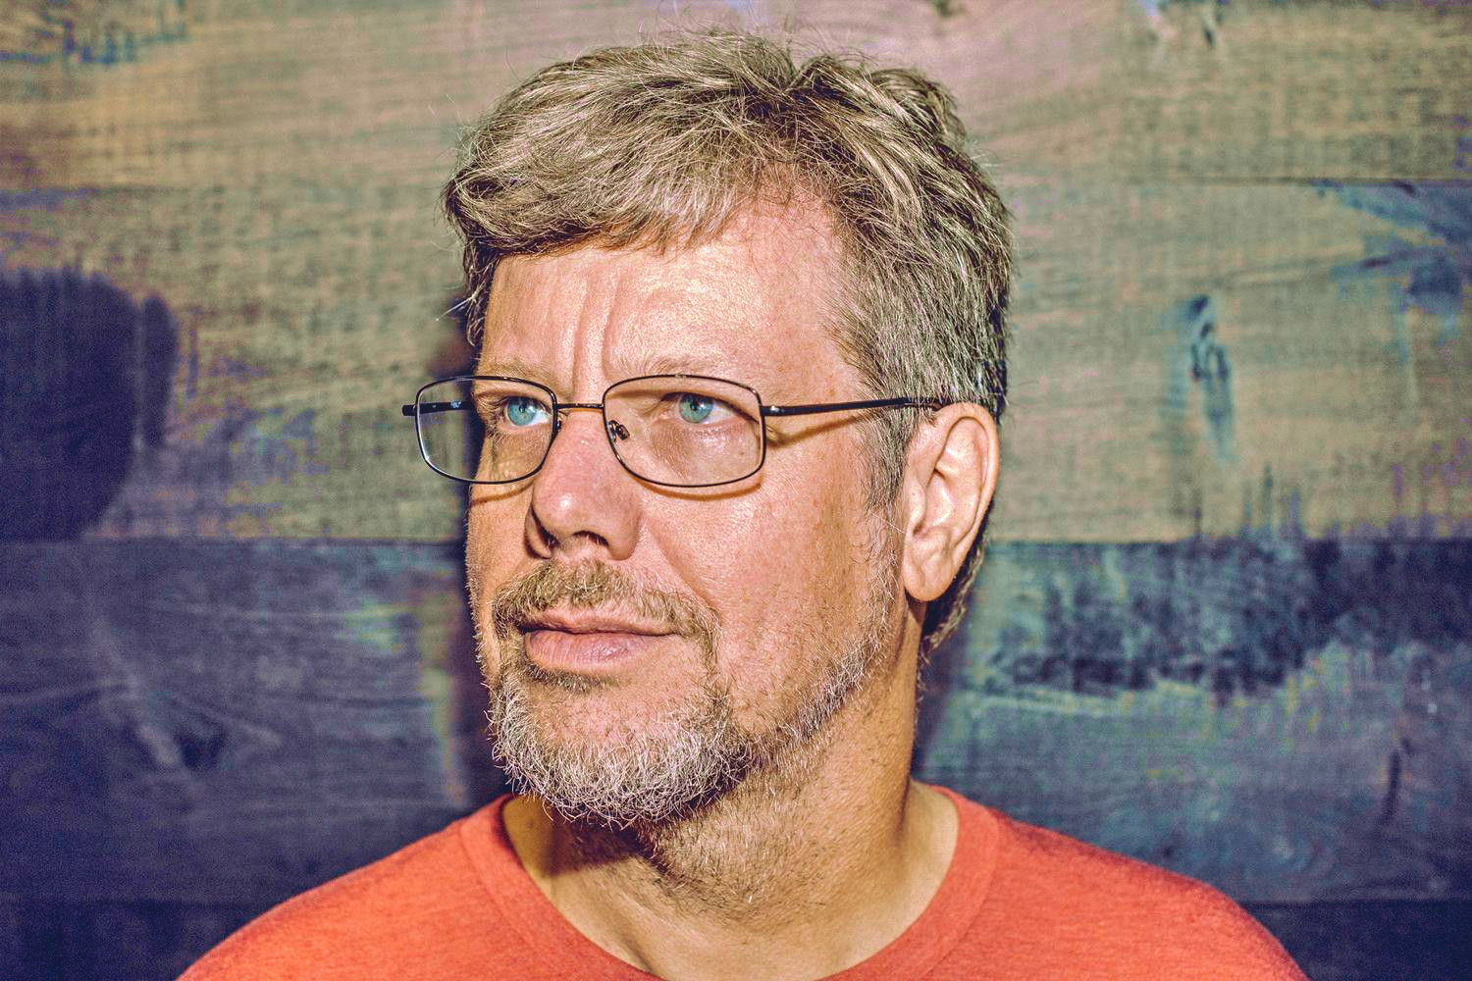
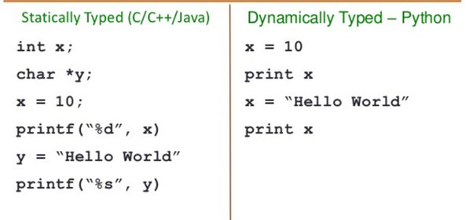
What’s Python
Python is a popular programming language. It was created by Guido van Rossum, and released in 1991.
It was mainly developed for emphasis on code readability, and its syntax allows programmers to express concepts in fewer lines of code.

Slide 4
What Can Python Do ?
Python can be used on a server to create web applications.
Python can be used alongside software to create workflows.
Python can connect to database systems. It can also read and modify files.
Python can be used to handle big data and perform complex mathematics.
Python can be used to create and apply AI applications(Machine Learning apps)
Python can be used for rapid prototyping, or for production-ready software development.

Slide 5
Why Python ?
Python works on different platforms (Windows, Mac, Linux, Raspberry Pi, etc).
Python has a simple syntax similar to the English language.
Python has syntax that allows developers to write programs with fewer lines than some other programming languages.
Python runs on an interpreter system, meaning that code can be executed as soon as it is written. This means that prototyping can be very quick.
Python can be treated in a procedural way, an object-oriented way or a functional way.

Slide 6
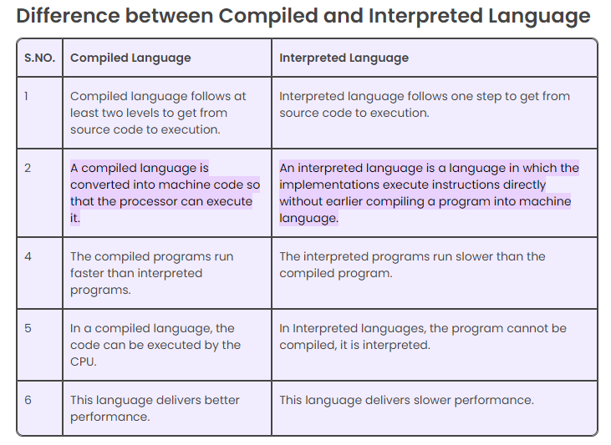
Python as Interpreted Language
In computer science, an interpreter is a computer program that directly executes instructions written in a programming or scripting language, without requiring them previously to have been compiled into a machine language program

Slide 7
Good To Know
The most recent major version of Python is Python 3, which we shall be using in this tutorial. However, Python 2, although not being updated with anything other than security updates, is still quite popular.
In this tutorial Python will be written in a text editor. It is possible to write Python in an Integrated Development Environment (IDE), such as Thonny, Pycharm, Netbeans , Eclipse VSCode which are particularly useful when managing larger collections of Python files.
Note that we’ll be using Google Colab throughout the learning fundamentals concepts

Slide 8
Python Syntax Compared To Other Programming Languages
Python was designed for readability, and has some similarities to the English language with influence from mathematics.
Python uses new lines to complete a command, as opposed to other programming languages which often use semicolons or parentheses.
Python relies on indentation, using whitespace, to define scope; such as the scope of loops, functions and classes. Other programming languages often use curly-brackets for this purpose.

Slide 9
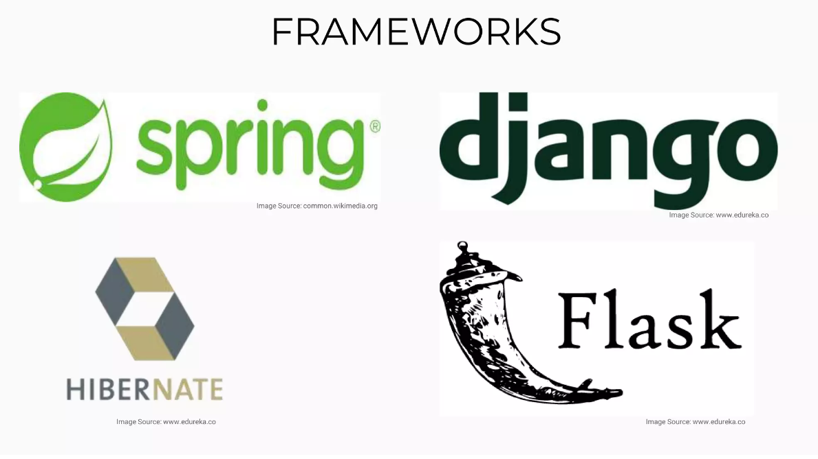
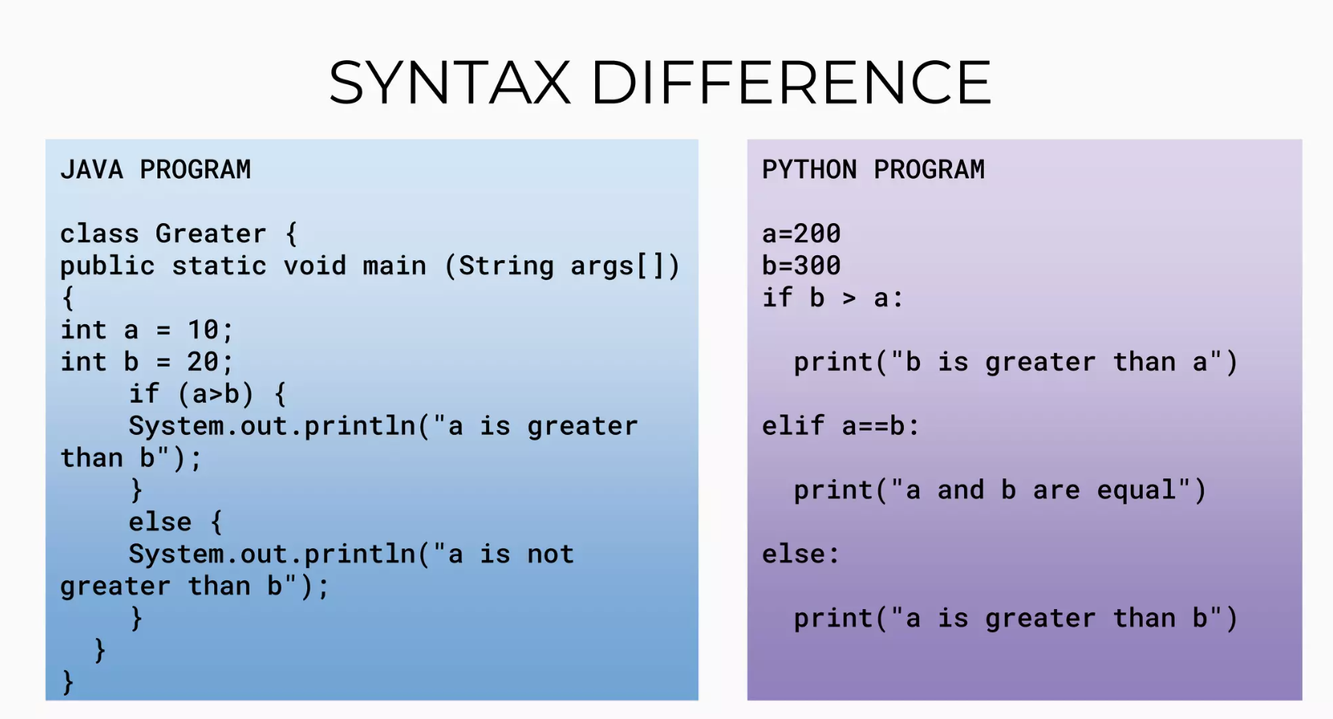

Slide 10
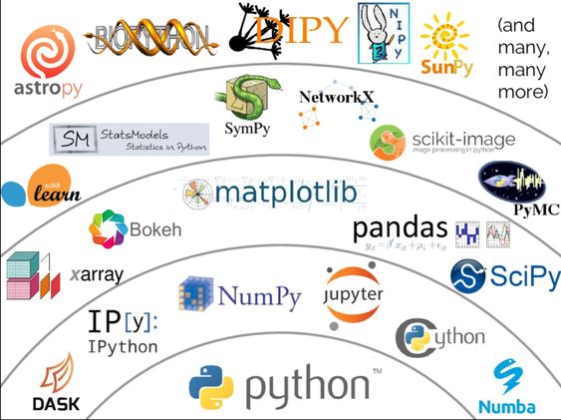
Bonus – Different Python Utilities For Different Areas
Later on, we’ll be using Numpy for mathematical operations,
pandas for data processing
matplotlib for data visualization
Sckitlearn (or sklearn) and tensorflow for machine learning and deep learning

Slide 11
REFERENCES
https://www.w3schools.com/python/python_intro.asp
https://www.geeksforgeeks.org/history-of-python/
https://byjus.com/gate/difference-between-compiled-and-interpreted-language/#:~:text=A%20compiled%20language%20is%20converted,a%20program%20into%20machine%20language.
https://www.slideshare.net/RutujaGholap/java-vs-python-250022203

